Slide 1

Environmental Impact Assessment
& Green Infrastructure
Principles, Systematic Process and Strategic Importance for Resilient, Sustainable Development
Presented by Group 12

Slide 2


What is EIA?
A systematic, proactive process used to identify, predict, evaluate, and manage environmental impacts of a proposed project before decisions are made.
Primary Purposes
Early Identification: Identify potential environmental impacts early in design.
Degradation Prevention: Predict consequences and prevent irreversible degradation.
Compliance & Balance: Support long-term sustainable equilibrium and compliance.

Slide 3





Why is EIA Needed?/
Predict Impacts Early
Mitigate Consequences
Anticipate biophysical and socio-economic hazards prior to committing major capital expenditure.
Formulate and mandate technical countermeasures to avoid, reduce, and offset negative outcomes.
Evaluate Alternatives
Public Participation
Compare locations, cleaner technologies, and engineering designs to select the greenest path.
Provide a transparent platform for affected communities and local stakeholders to voice concerns.

Slide 4


EIA 10-Step Process Overview
Stages 01 to 05
Stages 06 to 10
•
01. Screening: Determines if EIA is legally mandated.
•
06. Mitigation: Structured environmental hierarchy (Avoid, Reduce).
•
02. Scoping: Establishes spatial boundaries and Terms of Reference.
•
07. EIA Report: Formal submission of comprehensive dossier.
•
03. Baseline Study: Comprehensive field audit across all media.
•
08. Consultation: Public hearing with local stakeholders.
•
04. Impact Prediction: Modeling future pollution dispersion.
•
09. Decision Making: Statutory clearance or project rejection.
•
05. Alternatives: Evaluating locations and the 'no-project' option.
•
10. Monitoring: Post-commissioning surveillance and audits.

Slide 5
Step 1: Project Screening
Evaluation Parameters
Statutory Categorization
Screening dictates whether an EIA is required based on key parameters:
•
Category A — Mandatory Full EIA: Thermal power plants, mega-dams, refineries, and major mining operations.
•
Project Scale: Physical footprint, output volume, resource demand.
•
Category B — Targeted Review: Medium industrial units or regional highways requiring specific EMPs.
•
Location: Proximity to wetlands, wildlife biomes, and cities.
•
Activity Type: Chemical processing vs light assembly.
•
Category C — Exempt: Projects with negligible biophysical footprint.
•
Sensitivity: Vulnerability of local aquifers and soil.

Slide 6

Step 2: Project Scoping
Defining Project Boundaries
Scoping establishes the Terms of Reference (ToR) and outlines the depth of inquiry required for technical field surveys.
Geographical & Ecological Limits: Delineates affected drainage basins, airsheds, and sensitive ecological zones.
Stakeholder Networks: Identifies directly affected communities and sets public participation channels.
Focused Capital Allocation: Ensures consulting budgets and technical studies focus strictly on critical ecological risks.

Slide 7
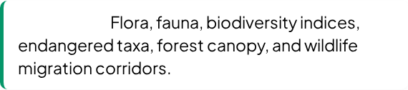
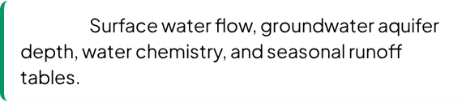
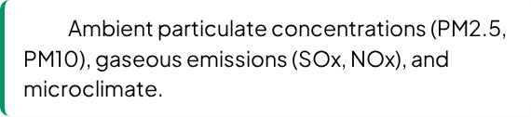
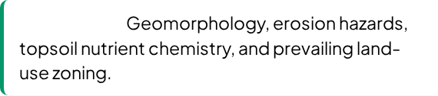
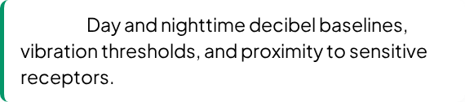

Step 3: Baseline Studies
Biological:
Water:
Air:
Land & Soil:
Noise:
Socio-Economic:

Slide 8
Step 4: Impact Prediction
Project Activity | Potential Environmental Impact | Impact Classification | Nature
Site Clearing | Topsoil stripping, sediment runoff into creeks | Short-Term, Local | Negative
Excavation & Hauling | Elevated fugitive dust (PM10) & machinery noise | Direct, Reversible | Negative
Industrial Processing | Stack gaseous emissions & wastewater effluent | Long-Term, Regional | Negative
Plant Footprint | Loss of native flora and wildlife habitats | Irreversible, Direct | Negative
Operations Phase | Direct local employment & commerce growth | Cumulative, Regional | Positive

Slide 9

Step 5: Project Alternatives
Project Alternatives
The "No-Project" Alternative
Systematic evaluation of cleaner alternative engineering pathways:
Mandatory baseline scenario examining outcomes if the project is cancelled:
•
Alternative Locations: Siting away from pristine biomes.
•
Ecological Baseline Preserved: Native ecosystems, pristine habitats, and water tables remain undisturbed.
•
Alternative Technologies: Low-emission, closed-loop systems.
•
Economic Costs Foregone: Quantifies forfeited energy generation, jobs, or regional logistics enhancements.
•
Alternative Designs: Reconfiguring to preserve watercourses.
•
Alternative Scheduling: Avoiding animal breeding seasons.

Slide 10
Step 6: Mitigation Measures
The Mitigation Hierarchy: Structured sequential framework designed to achieve zero net loss of biodiversity:
1. Avoid: Re-routing alignments to bypass sensitive native wetlands.
2. Minimize: Deploying baghouse filters, wet scrubbers, and baffles.
3. Restore: Bio-reclamation of decommissioned quarries and mines.
4. Offset: Funding protected nature reserves to balance impacts.

Slide 11


Step 7: Preparation of EIA Report
Core Documentation
Strategic Action Plans
•
Executive Summary: Non-technical synopsis prepared for public disclosure, press, and tribunals.
•
Management Plan (EMP): Institutional framework defining mitigation actions, budget allocation, and schedules.
•
Project Description: Engineering layout maps, resource intake, chemical inventories, and workforce scale.
•
Emergency Protocols: Disaster response measures for chemical spills, boiler failures, or structural accidents.
•
Baseline Audit: Seasonal findings on air, water chemistry, noise, ecology, and socio-economic surveys.
•
Impact Quantification: Mathematical dispersion modeling of emissions, hydrological drawdowns, and noise.

Slide 12


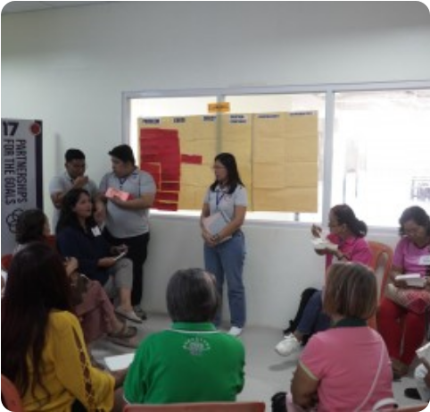

Step 8: Public Consultation
Forum Focus & Benefits
Statutory public consultation allows affected populations to directly voice concerns, contribute indigenous knowledge, and propose alternatives.
Identifies Blindspots: Surfacing risks overlooked by surveys.
Builds Trust: Cultivates grassroots consensus and goodwill.
Prevents Litigation: Avoids expensive legal delays down the road.

Slide 13
Step 9: Decision Making
Approval
Conditional
The project complies with statutory sustainability criteria and exhibits manageable, mitigated ecological risks.
Approval granted subject to binding mandates (e.g. continuous CEMS monitors, zero liquid discharge systems).
Revision Required
Rejection
The EIA dossier lacks critical data; developer must conduct additional baseline surveys or alter engineering.
Projected environmental hazards are unacceptable, irreversible, and non-mitigable within carrying capacities.

Slide 14

Step 10: Environmental Monitoring
Ongoing Surveillance
Corrective Action Loop
EIA does not terminate when a clearance is awarded. Monitoring verifies:
•
Whether predicted environmental impacts are occurring within limits.
Provides regulatory authorities with the legal power to impose immediate fines, demand equipment upgrades, or suspend operations if environmental thresholds are breached.
•
If mandated mitigation measures are technically performing.
•
Statutory emission and effluent standards are maintained over time.
•
Management plans are actively funded and implemented.

Slide 15



Environmental Management Plan
Operational Controls
Institutional Architecture
•
Pollution Control: Operation of baghouse filters, scrubbers, and ETPs.
•
Dedicated Cell: In-house environmental safety officers and engineers.
•
Waste Management: Manifest tracking and secure containment.
•
Budget Allocation: Ring-fenced capital and operational funding.
•
Water Conservation: Closed-loop cooling and rainwater harvesting.
•
Emergency Response: Disaster drill protocols and fire fighting reserves.
•
Biodiversity Care: Buffer zone afforestation and noise barriers.
•
Statutory Reports: Bi-annual submission of compliance records.

Slide 16
Advantages and Limitations
Key Advantages
Practical Limitations
•
Proactive Risk Reduction: Solves hazards before capital construction.
•
Time-Consuming: Seasonal baseline surveys can take 6–12 months.
•
Better Planning: Integrates environmental factors into master design.
•
Significant Costs: Requires specialized multi-disciplinary consultants.
•
Resource Efficiency: Lowers waste creation and raw material demand.
•
Modeling Uncertainty: Complex biomes can respond unpredictably.
•
Legal Safeguard: Shields developers against statutory liabilities.
•
Enforcement Gaps: Post-clearance monitoring is often under-resourced.

Slide 17
Green Infrastructure
Nature-Based Solutions for Resilient, Liveable, and Sustainable Cities — restoring ecological balance, absorbing stormwater surges, and creating cooler, healthier communities.

Slide 18
Introduction
Why bringing nature into our cities matters
• Green infrastructure connects natural and semi-natural spaces so they can benefit both people and the environment.
• Plants, soil and water systems can help tackle urban problems such as flooding, pollution and excessive heat.
• It supports cities that are healthier, more sustainable and better prepared for climate-related challenges.
Examples
Parks • Green roofs • Rain gardens
Green walls • Urban forests

Slide 19
What is Green Infrastructure?
Using natural systems to perform useful infrastructure functions
• Green infrastructure uses vegetation, soil and natural water systems to provide services that are often handled by engineered infrastructure.
• Unlike a single green space, it is planned as a connected system that can manage water, heat, pollution and habitats.
• Simply put: it means using nature as part of the way we design and manage communities.
🌳
Urban forests & parks
🌿
Green roofs & walls
🌧️
Rain gardens
💧
Wetlands & ponds
🛣️
Permeable surfaces

Slide 20
Major Types of Green Infrastructure
Urban Green Spaces
Parks, gardens, street trees and urban forests create shade, recreation and habitat.
Green Buildings
Green roofs, living walls and planted terraces add vegetation to built-up areas.
Water Management
Rain gardens, bioswales and constructed wetlands collect, slow and filter stormwater.
Green Transport
Greenways, tree-lined streets and planted cycle routes connect people with greener spaces.

Slide 21
How Does Green Infrastructure Work?
Natural processes help manage water, heat and pollution
1
→
2
→
3
→
4
→
5
Rain falls
Plants slow the flow
Soil absorbs water
Pollutants are filtered
Less runoff reaches drains
• Absorbs and stores rainwater before it becomes surface runoff.
• Vegetation and soil can trap or filter some pollutants.
• Trees and plants provide shade and help cool surrounding areas.
• Green spaces also create habitats for plants, insects and wildlife.

Slide 22
Benefits of Green Infrastructure
🌍 Environmental
• Reduces flooding and stormwater runoff
• Improves air and water quality
• Lowers urban temperatures
• Provides habitat and supports biodiversity
👥 Social
• Creates attractive public spaces
• Encourages recreation and outdoor activity
• Supports health and well-being
• Makes neighborhoods cooler and more pleasant
💰 Economic
• Can reduce some stormwater costs
• May increase property attractiveness
• Can reduce cooling needs in some settings
• Creates green-sector employment

Slide 23
Green Infrastructure in Action
A simple example: managing heavy rainfall
• Imagine a city where most surfaces are covered by roads, roofs and concrete.
• During heavy rain, water quickly runs across these hard surfaces and can overwhelm drainage systems.
• Adding trees, planted areas, rain gardens and permeable surfaces gives the water more places to slow down, soak in and be stored.
• The result can be less runoff, lower flood risk and cleaner water entering natural waterways.
Key idea
Green infrastructure does not just make a city look greener — it makes natural processes work for the city.

Slide 24
Challenges and Limitations
• Good design is essential; a poorly planned system may not deliver the expected benefits.
• Vegetation and water-management features require regular maintenance.
• Initial installation can require funding, materials and skilled planning.
• Dense urban areas may have limited space for large green features.
• Some benefits, such as improved ecosystem health, may take time to become noticeable.

Slide 25
Conclusion
Green infrastructure connects development with natural systems
• It uses nature — including trees, soil, plants and water bodies — to address real urban problems.
• It can reduce flooding, pollution and heat while supporting biodiversity.
• It also creates social benefits such as healthier, more attractive and usable public spaces.
• By combining environmental, social and economic benefits, it supports sustainable and climate-resilient communities.
Take-away
Work with nature, rather than working against it.

Slide 26









Nature-Based Solutions (NbS)
Ecosystem Restoration
Green Infrastructure
Sustainable Management
Rehabilitating degraded native forests, peatlands, and coastal wetlands to enhance biodiversity and lock away carbon.
Integrating green roofs, park corridors, and permeable pavements into cities to lower extreme heat and absorb floods.
Deploying watershed protection and sustainable land-use practices to deliver clean freshwater and food security.

Slide 27

Climate Mitigation with NbS
Strategic Economic & Climate Impact
Cost-effective climate mitigation needed by 2030 can be delivered directly through Nature-Based Solutions and living ecological infrastructure.
37%
Global Climate Mitigation Target by 2030
Up to 50% Cost Savings: Ecological infrastructure delivers lower initial capital and lifetime maintenance costs compared to single-purpose concrete gray systems.

Slide 28
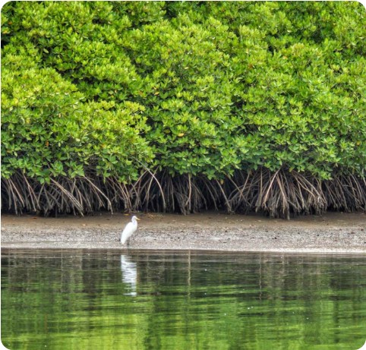



Global Case Studies of NbS
Coastline Defense
Peatland Rewetting
Seychelles mangrove rehabilitation stabilized shorelines and absorbed wave surge energy, securing coastal fisheries and preventing erosion.
Northern European peatland rewetting locked away thousands of tonnes of carbon per hectare while restoring rare wetland biodiversity.

Slide 29
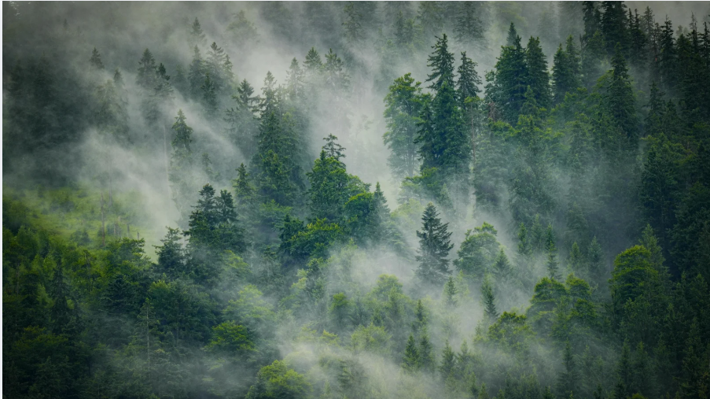

Questions & Discussion
Bridging infrastructure development with planetary boundaries through rigorous impact assessments and living Nature-Based Solutions.

Slide 30




Short Questions (Part 1)
1. What is Environmental Impact Assessment (EIA)?
Answer: EIA is a systematic process used to identify, predict, evaluate, and manage the environmental impacts of a proposed project before decisions are made.
2. What is the Precautionary Principle?
Answer: It states that lack of full scientific certainty should not delay measures needed to prevent environmental degradation.
3. What is Green Infrastructure?
Answer: Green Infrastructure is an interconnected network of natural and semi-natural areas designed to provide ecosystem services to urban populations.

Slide 31
Short Questions (Part 2)
4. What is the Polluter Pays Principle?
Answer: The organization causing pollution is legally and financially responsible for managing waste and remediating the environmental damage.
5. What is an Environmental Management Plan (EMP)?
Answer: An EMP defines environmental mitigation actions, budget allocation, responsibilities, and implementation schedules.

Slide 32










Long Questions 1
Explain the 10-step process of EIA.
01.
02.
03.
04.
05.
06.
07.
08.
09.
10.

Slide 33
Long Questions 2
Explain the major objectives of EIA.
Predict environmental impacts early.
Mitigate negative consequences.
Evaluate alternative locations, technologies, and designs.
Provide opportunities for public participation.
Balance economic development with environmental protection.

Slide 34



Long Questions 3
Explain Green Infrastructure and its major components.
Answer: Green Infrastructure uses natural and semi-natural systems to provide environmental services. Its major components are:
Vegetation
Water Systems
Trees, plants, gardens, and urban forests.
Wetlands, retention ponds, and bioswales.
Healthy Soil
Green Spaces
Absorbs rainwater and recharges groundwater.
Parks, greenways, and ecological corridors.

Slide 35






Long Questions 4
Explain the environmental benefits of Green Infrastructure.
Answer: Green Infrastructure delivers multiple co-benefits across urban catchments:

Slide 36
Long Questions 5
Explain the mitigation hierarchy in EIA.
Answer: The mitigation hierarchy consists of four stages:
Avoid: Avoid sensitive areas and fragile habitats.
Minimize: Reduce unavoidable impacts with engineering controls.
Restore: Restore damaged ecosystems through bio-rehabilitation.
Offset: Compensate for remaining impacts through conservation measures.

Slide 37


